Slide 1

Uber Data Analysis in New York City
Exploring Urban Mobility and Operational Dynamics

Slide 2

Introduction
In the rapidly evolving landscape of urban transportation, ride-sharing services have emerged as a cornerstone of city mobility. Uber, offering millions of rides daily across the globe, represents a significant portion of this mobility. This project delves into the intricate dynamics of Uber rides in New York City, aiming to uncover patterns, demands, and operational insights.

Slide 3

Project Scope
Utilizing a comprehensive dataset of Uber pickups in New York City, this project seeks to answer pivotal questions illuminating the operational and demand patterns. The analysis provides a granular understanding of how, when, and where Uber's services are most utilized, reflecting the ebb and flow of city life.

Slide 4

Key Questions Addressed
1. Monthly Demand Dynamics: Identifying the month with maximum Uber pickups to uncover seasonal patterns.
2. Hourly Rush Analysis: Analyzing daily demand on an hourly basis to pinpoint rush hours.

Slide 5
Key Questions Addressed (Cont'd)
3. Fleet Utilization: Determining which base number has the most active vehicles to explore operational efficiency.
4. Geospatial Demand: Identifying high-demand locations to optimize fleet positioning.
5. Temporal and Spatial Rush Analysis: Examining rush patterns to refine service intensity.

Slide 6

Significance
The findings from this project reflect Uber's operational footprint in NYC and serve as a microcosm of urban mobility challenges and opportunities. This analysis aims to contribute to urban transportation planning, ride-sharing service optimization, and the evolution of city mobility.

Slide 7

Data Preparation and Analysis Methods
- Data Collection and Cleaning:
Utilized comprehensive Uber pickups dataset in NYC. Employed Pandas for data cleaning, preprocessing, handling missing values, and parsing dates.
- Analytical Techniques:
Conducted exploratory data analysis (EDA) and statistical analysis to understand demand patterns and identify key periods.
- Python Libraries Used:
Pandas for data manipulation, NumPy for numerical operations, Matplotlib and Seaborn for visualization, and Scikit-learn for predictive modeling.
- Rationale and Approach:
Chose Python for its flexibility and support community. Aimed to provide a holistic view of Uber's dynamics through statistics and visualization.

Slide 8

Data Collection and Cleaning
- Comprehensive dataset of Uber pickups in NYC.
- Data cleaning and preprocessing with Pandas: handling missing values, parsing dates, and categorizing data for analysis.
- Exploratory data analysis (EDA) to identify patterns, trends, and anomalies.
- Statistical analysis for distribution, variance, and key demand periods.

Slide 9

Analytical Tools and Rationale
- Python Libraries Used: Pandas, NumPy, Matplotlib & Seaborn for visualization, Scikit-learn for predictive modeling.
- Chosen for their flexibility, efficiency, and extensive community support.
- Aim: To provide a comprehensive view of Uber's operational dynamics through a blend of descriptive statistics, temporal analysis, and visualization.

Slide 10
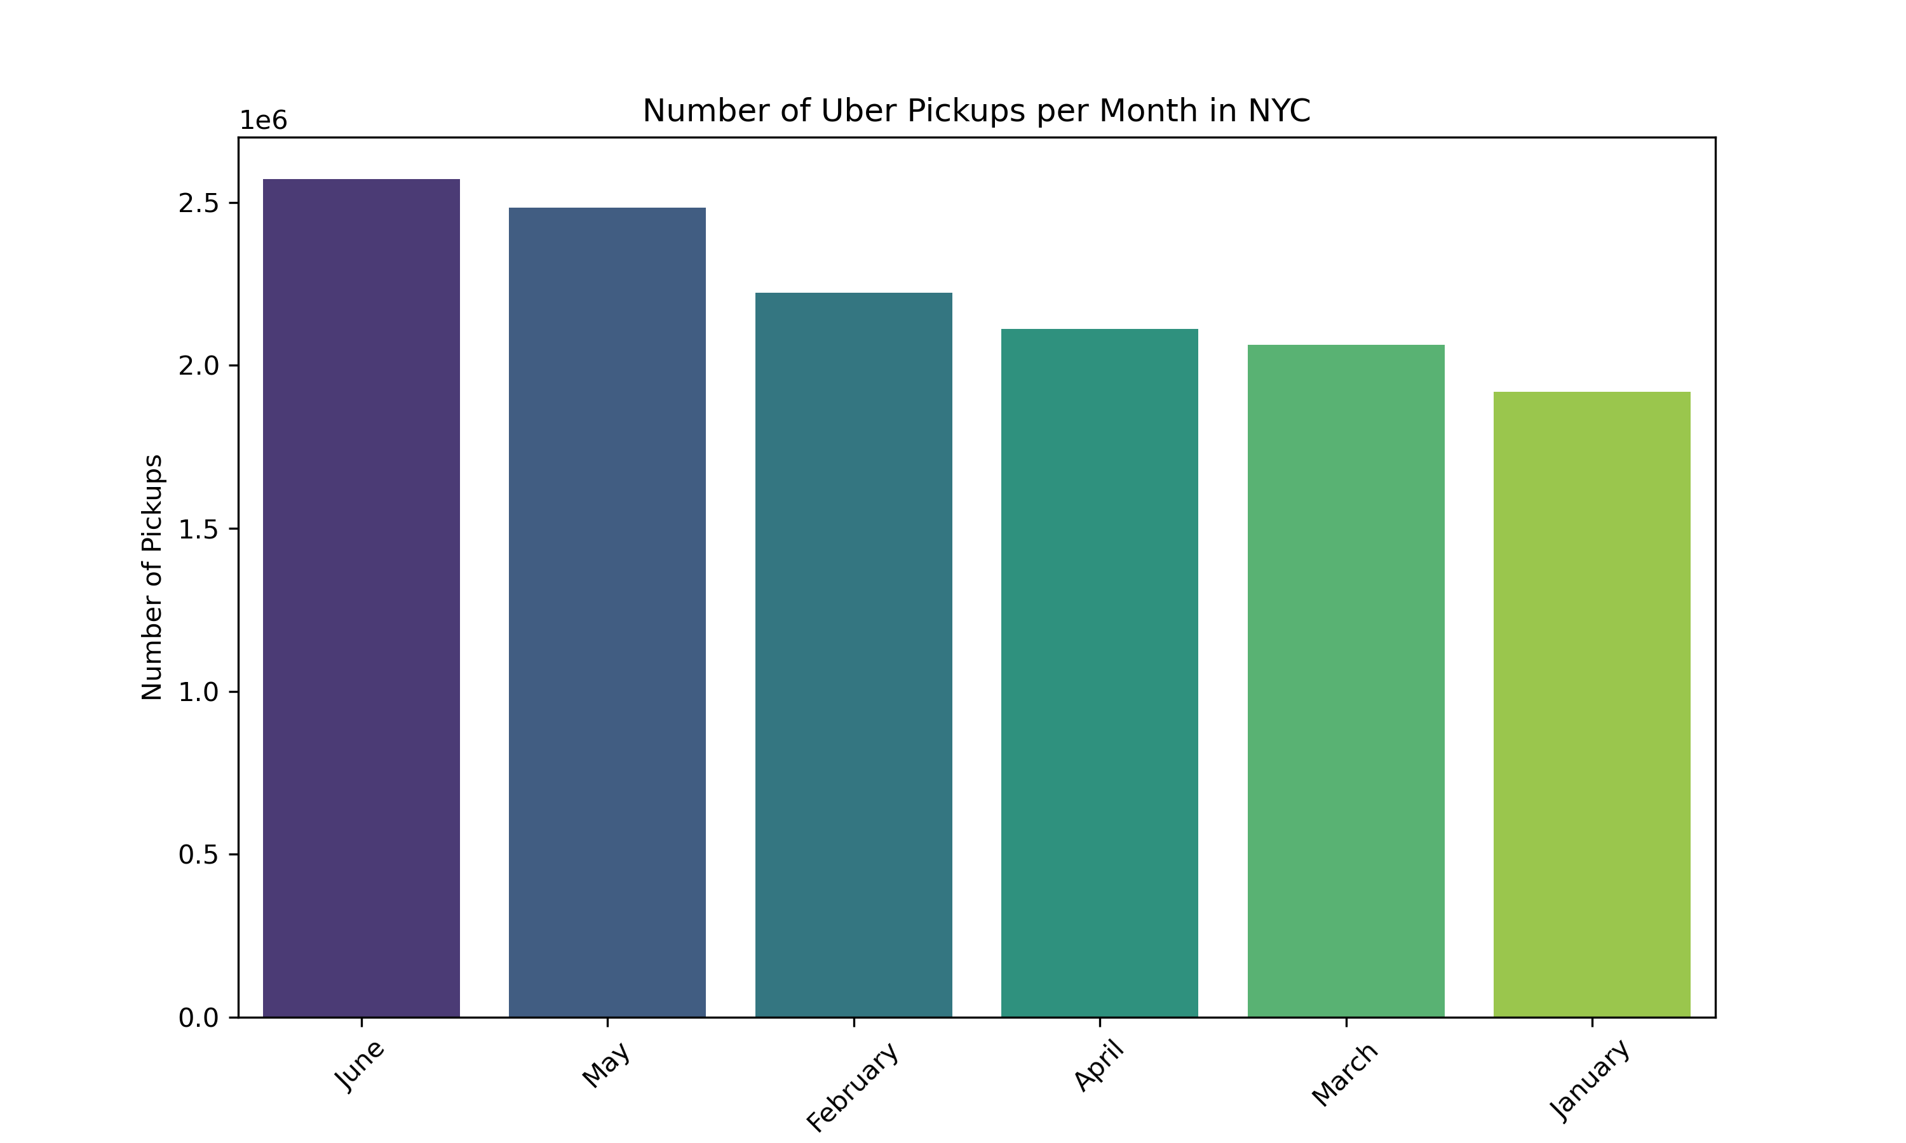
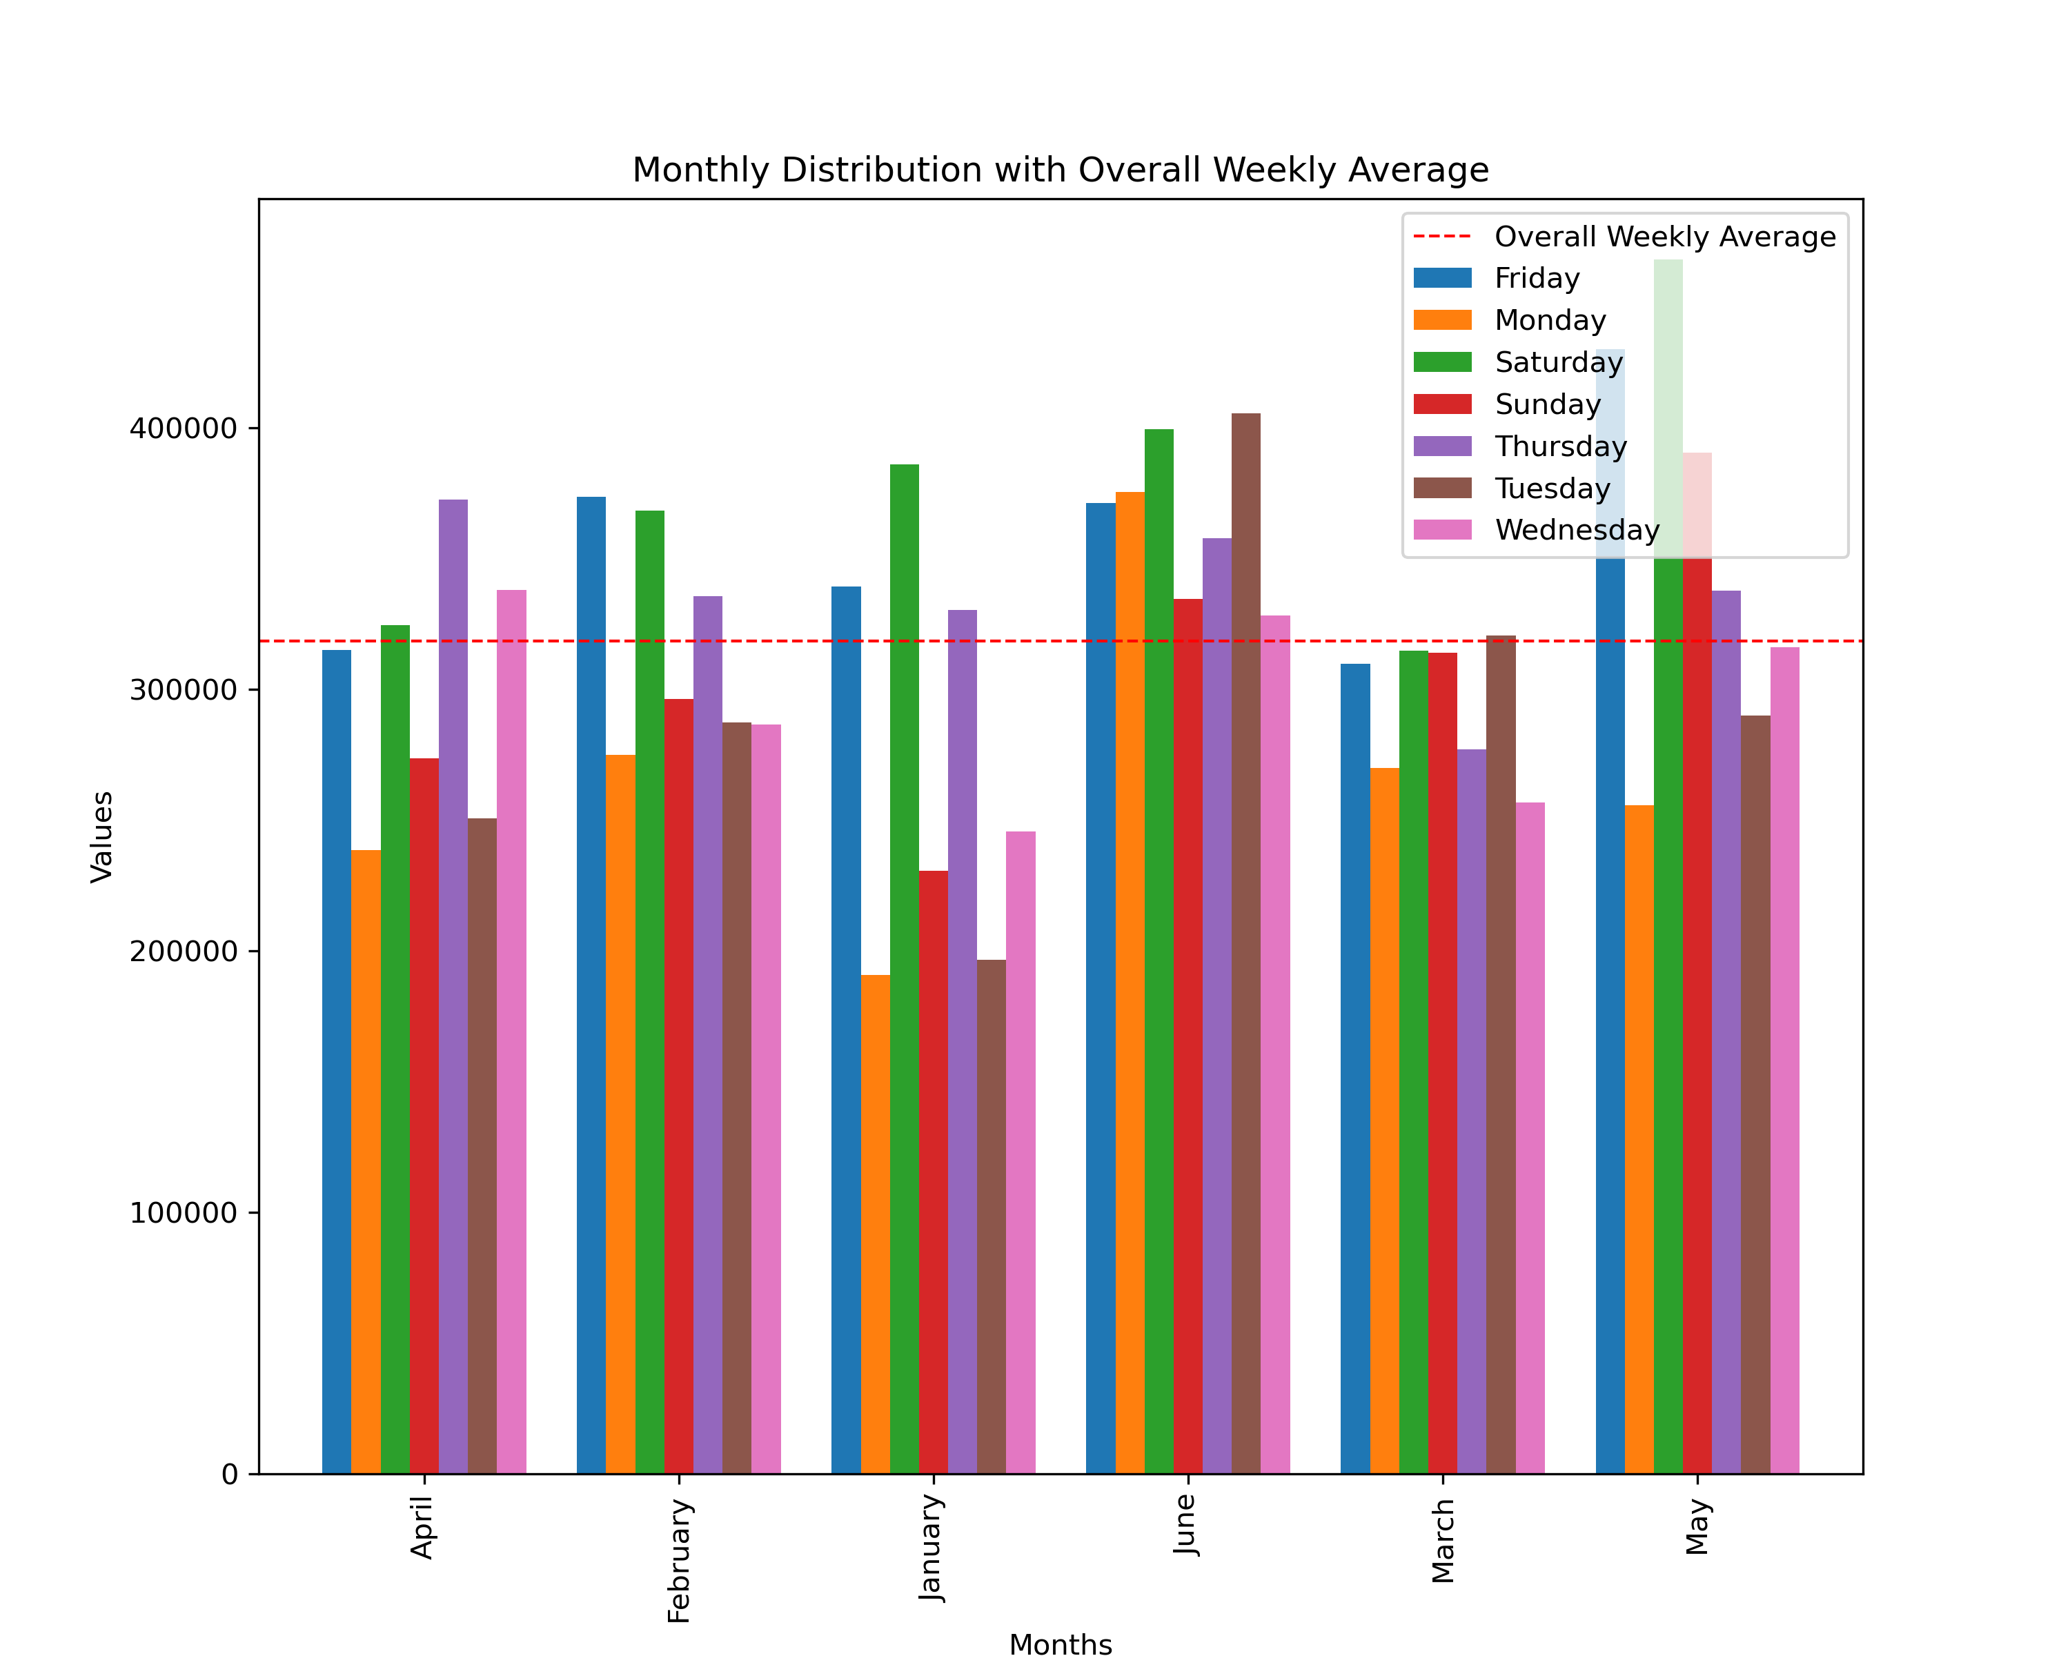
Monthly Demand Dynamics

Slide 11

Monthly Demand Dynamics
Analysis of Uber pickups by month revealed a clear pattern in demand fluctuations, suggesting seasonal variations in rider behavior. Peak demand in June, and on weekends indicates the importance of strategic fleet management.

Slide 12
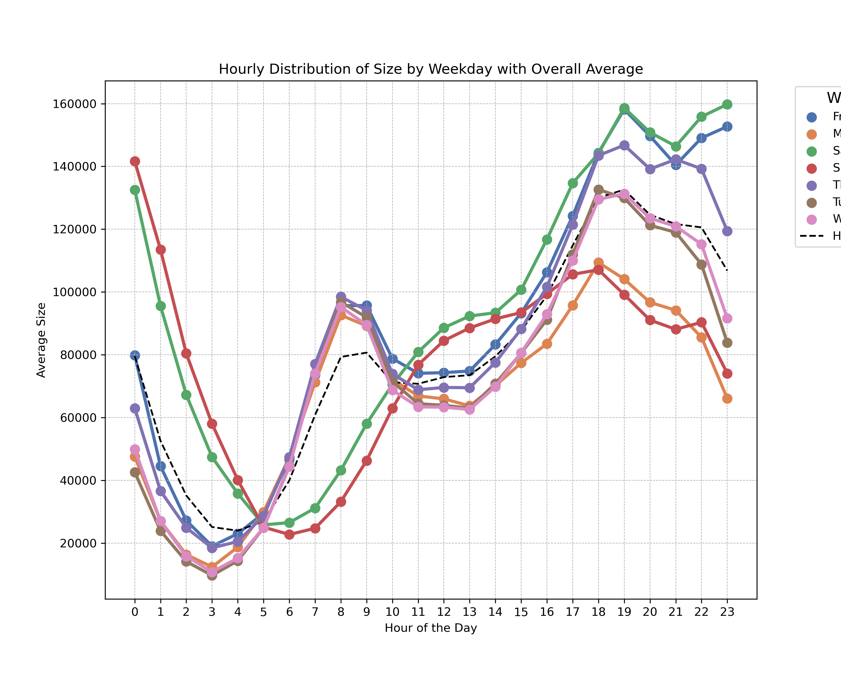
Hourly Rush Analysis

Slide 13

Hourly Rush Analysis
The hourly distribution of Uber pickups showcases significant spikes during rush hours, highlighting the city’s commuting patterns. Targeted deployment of drivers can meet demand efficiently.

Slide 14
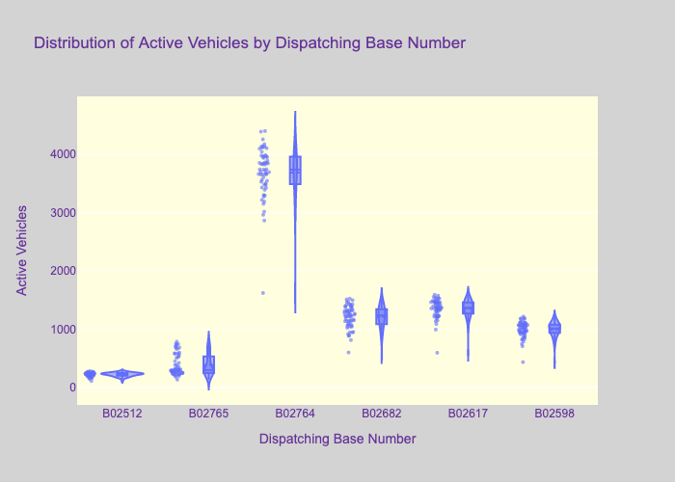
Fleet Utilization and Base Activity

Slide 15
Fleet Utilization and Base Activity
Base B02764 exhibits the highest number of active vehicles, surpassing 4000.
The spread of active vehicles for Base B02764 is the widest, indicating a larger range of values.
The median value for Base B02764, represented by the white dot within the violin, is higher than that of all other bases shown.
Due to the dense clustering of data points at the higher end, Base B02764 is the clear leader in vehicle activity.

Slide 16
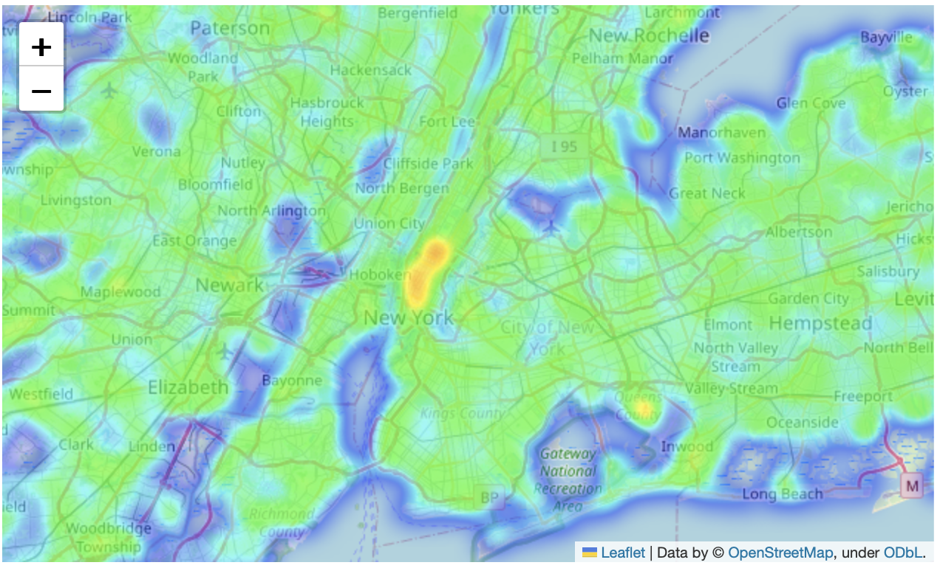
Rush location

Slide 17

Rush Location (Cont.)
The most significant rush is apparent in the area of Lower Manhattan, specifically around the Financial District. This is indicated by the bright yellow to orange areas, which represent the highest intensity on the heatmap.
Moderate rush areas are highlighted in light green to blue and are distributed across various parts of the city including Newark, Elizabeth, and Jersey City.
The least amount of rush is indicated by the dark blue areas, which cover the majority of the surrounding regions.

Slide 18
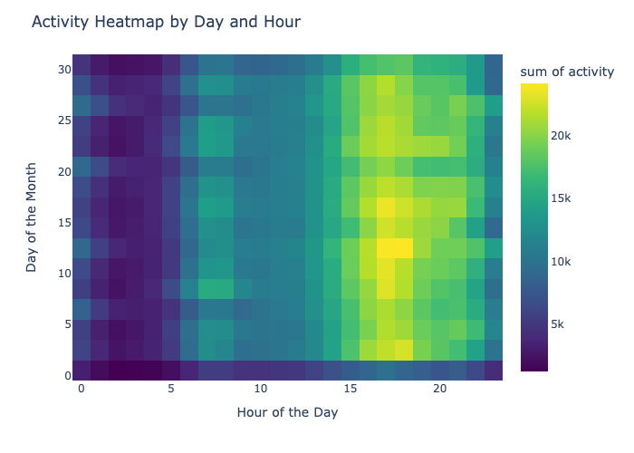
Pick Activity

Slide 19

Pick Activity (Contd.)
Peak activity is observed in the evening, especially around 6 PM.
Afternoon to evening hours see a progressive increase in activity.
Higher levels of activity are noted in the latter half of the month, particularly in the evening.
The early morning hours, from midnight to 5 AM, show the lowest activity levels.
Weekends may display different patterns, potentially showing peaks in late-night or early-morning hours.

Slide 20

Conclusion
Through our detailed analysis of activity levels based on the provided data, we've uncovered significant patterns in the daily and weekly flow of activity:
Evening Rush: A pronounced peak in activity during the evening hours, specifically around 6 PM, suggests a high demand for services coinciding with the end of the typical workday. This highlights a critical window where resource allocation should be maximized to meet the surge in user demand.
Progressive Increase: The gradual rise in activity from afternoon to evening underscores the importance of a dynamic approach in resource distribution that adapts to the increasing demand throughout the day.
Monthly Trends: The latter half of the month shows a notable increase in activity during evening hours, which could be indicative of pay cycles, social patterns, or other monthly events affecting behavior. Understanding these trends allows for strategic planning and targeted marketing.
Early Morning Lull: The low activity levels from midnight to 5 AM provide an opportunity for scheduled downtime and maintenance, as the demand for services is at its lowest.
Weekend Variability: The potential for different activity patterns on weekends, possibly extending into late-night or early-morning hours, suggests a shift in user behavior that could be leveraged for special weekend services or promotions.

